Slide 1


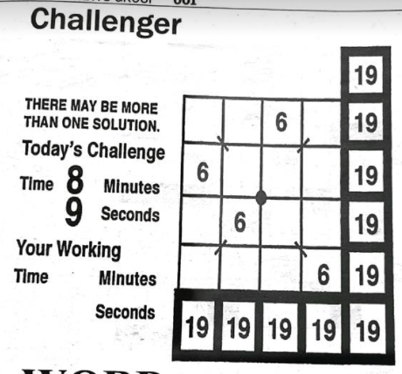




pSUS: A Challenger Puzzle Solver Using SMT
Tyler Ekaireb | Gautam Mundewadi | Ganesh Sankaran
Contributions
User Workflow
Experimental Results
A symbolic compilation formalization for Challenger
A Challenger puzzle solver and generator
pSUS (Puzzle Solver Using SMT)
Can be generalized to other puzzles
A dataset of 22 real-world Challenger puzzles
A set of experiments that evaluate pSUS
19
_ _ 6 _ 19
6 _ _ _ 19
_ 6 _ _ 19
_ _ _ 6 19
19 19 19 19 19
Background
Goal: given a puzzle with holes, fill them in such that
All rows sum to target sums (rightmost column)
All columns sum to target sums (bottom row)
Both diagonals sum to target sums (corner entries)
Puzzle can be expressed as an SMT formula
Quantifier-free linear integer arithmetic constraints
User converts puzzle to input format for pSUS
The number of operations Z3 executed to solve real-world puzzles had almost no association with human solving time. This may suggest that humans solve this puzzle in a very different way than a CDCL-based approach.
python3 solver.py -i puzzle1.txt -o solved.txt
Tool Architecture
User calls pSUS from the command line
; part of entry clause
; declaration for an entry at (3, 2) with value 6
(declare-const x_3_2 Int)
(assert (= x_3_2 6))
; declaration for a hole at (2, 3)
(declare-const x_3_3 Int)
(assert (and (>= x_3_3 1) (<= x_3_3 9)))
; part of row clause
(assert (= (+ x_3_1 x_3_2 x_3_3 x_3_4) 19))
pSUS compiles puzzle to SMT formula, passes to Z3
19
9 1 6 3 19
6 3 9 1 19
3 6 1 9 19
1 9 3 6 19
19 19 19 19 19
The number of operations Z3 executed to solve randomly generated puzzles increased with the
number of holes in the puzzle (looks exponential)
size of the puzzle (looks quadratic)
pSUS outputs solved puzzle
CMPSC 292C, Spring 22 | Acknowledgements: Professor Yu Feng
Notes:
1

